Slide 1




AWS Foundation
AWS Lambda, Elastic Beanstalk & AWS OpsWorks
Copyright IntelliPaat, All rights reserved
Notes:
Welcome back to the forth module of data science.

Slide 2
Agenda
Distributed Application Architecture
What is Elastic Beanstalk?
17
CloudFormation vs OpsWorks
1
9
2
What is AWS Lambda?
10
How does Beanstalk work?
18
AWS OpsWorks Services
11
Elastic Beanstalk Concepts
19
AWS OpsWorks Stacks
3
How Lambda is Different?
11
Benefits & Limitations of Lambda
12
Demo: Launching a sample application
20
Demo: Launching a stack
4
5
How does Lambda work?
13
Elastic Beanstalk Pricing
21
AWS OpsWorks Pricing
14
What is Configuration Management?
22
6
Use Cases of Lambda
Quiz
7
Lambda Concepts
15
What is AWS OpsWorks?
8
Using Lambda with S3 & Hands-on
16
AWS OpsWorks Benefits

Slide 3
Distributed Application Architecture

Slide 4

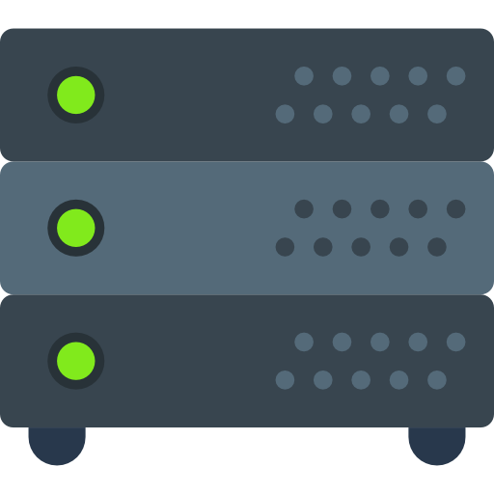
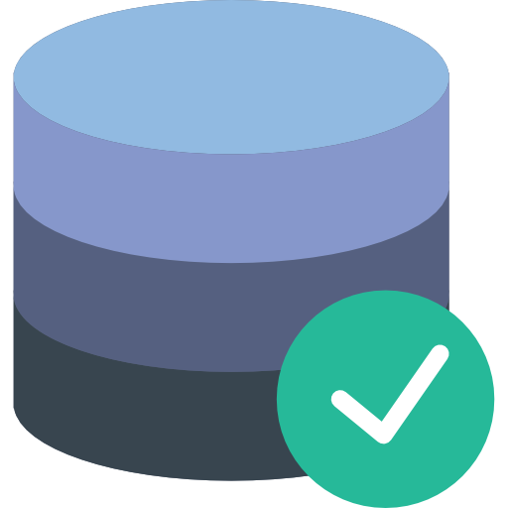
Distributed Application Architecture
A typical application has three components – Frontend, Backend, and Database or other storage types
Frontend (Website)
Backend (Logic)
Database Service

Slide 5





Distributed Application Architecture
Legacy Web Application
Backend
Frontend (Website)
Database

Slide 6

Distributed Application Architecture
Frontend
Backend
Database

Slide 7

Distributed Application Architecture
The Frontend, Backend, and the database services use dedicated servers.
Frontend Server
Backend Server
Database Server
Only contains the design and user interface
All the processing and logical operations are done here
Database server is only triggered when it is queried

Slide 8
What is AWS Lambda?

Slide 9

What is AWS Lambda?
AWS Lambda is a ‘serverless’ compute service where your code is triggered in response to a event occurrence and it also manages the underlying compute resources for you!

Slide 10
How Lambda is Different?

Slide 11

How Lambda is Different?
AWS Lambda
Amazon EC2
AWS Lambda is a Platform as a Service (PaaS) with a remote platform to run & execute your back-end code.
Environment restrictions, as it is restricted to few languages only.
Just choose your environment where you want to run your code and push the code into AWS Lambda.
No flexibility to log in to compute instances, choose customized operating system or language runtime.
AWS EC2 is an Infrastructure as a Service (IaaS) provided with the virtualized computing resources.
No environment restrictions are there.
For the first time in EC2, you have to choose the OS and Install all the software required and then push your code in EC2.
Offers the flexibility to choose the variety of instances, custom operating systems, network & security patches etc.

Slide 12

How Lambda is Different?
AWS Lambda
Elastic Beanstalk
AWS Lambda is used only for running and executing your Back-end code
You cannot select the AWS resources, like a type of EC2 instance, lambda provides you resources based on your workload.
It is a stateless system.
Deploy and manage the apps on AWS Cloud without worrying about the infrastructure that runs those applications.
Freedom to select AWS resources, like, choose an EC2 instance type which is optimal for your application.
It is a stateful system.

Slide 13
Benefits & Limitations of Lambda

Slide 14


Benefits of AWS Lambda
Serverless Architecture
Code freely
No VM needs to be created
Pay-as-you-go
Monitor you performance

Slide 15


Limitations of AWS Lambda
The maximum disk space provided is 512 MB for the runtime environment.
Its memory volume varies between 128 to 3008 MB to the function while execution
The function timeout is set to only 900 seconds (15 Minutes). Default is 3 seconds.
Only available languages in the Lambda editor can be used

Slide 16
How does it work?

Slide 17





How does it work?
First you upload your code to Lambda in one or more lambda functions
AWS Lambda will then execute the code in your behalf
After the code is invoked, Lambda automatically takes care of provisioning and managing the required servers
Upload to Lambda Function

Slide 18
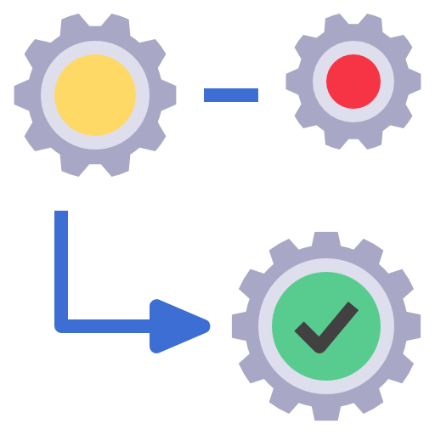
How does it work?
First you upload your code to Lambda in one or more lambda functions
AWS Lambda will then execute the code in your behalf
After the code is invoked, Lambda automatically takes care of provisioning and managing the required servers

Slide 19


How does it work?
First you upload your code to Lambda in one or more lambda functions
AWS Lambda will then execute the code in your behalf
After the code is invoked, Lambda automatically takes care of provisioning and managing the required servers
Provisioning servers
Monitor and manage servers

Slide 20
Use Cases of Lambda

Slide 21



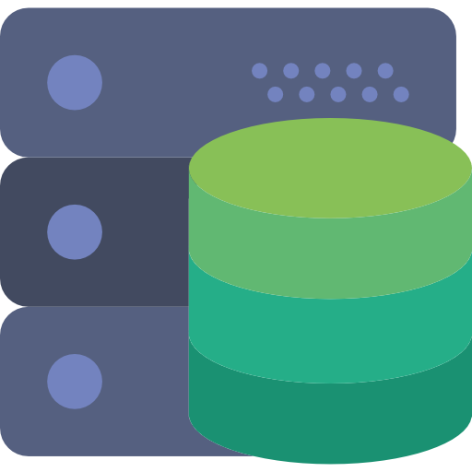
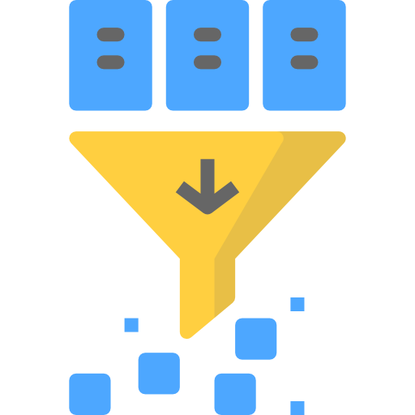

Use Cases of Lambda
Building a serverless website allows you to focus on your website code.
You don’t have to manage and operate its infrastructure.
Hosting your static website over S3 and then making it available using AWS Lambda makes it easier for the users to keep track of their resources being used.
Serverless Websites
Automated Backups
Filter and Transform data

Slide 22
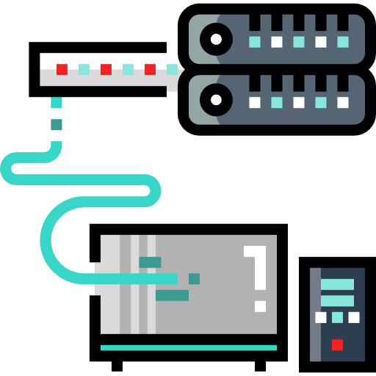
Use Cases of Lambda
One can easily schedule the Lambda events and create back-ups in their AWS Accounts.
Create the back-ups, check if there are any idle resources or not, generate reports using Lambda in no time.
Serverless Websites
Automated Backups
Filter and Transform data

Slide 23
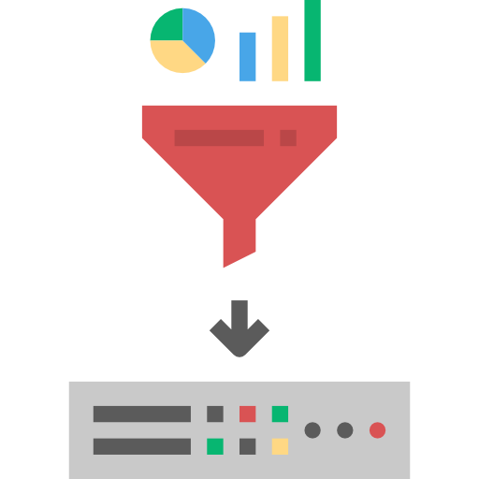
Use Cases of Lambda
One can easily use it for transferring the data between Lambda and other Amazon Services like S3, Kinesis, Redshift and database services
Also, you can filter the data before sending
One can easily transform and load data between Lambda and these services.
Serverless Websites
Automated Backups
Filter and Transform data

Slide 24
Lambda Concepts

Slide 25


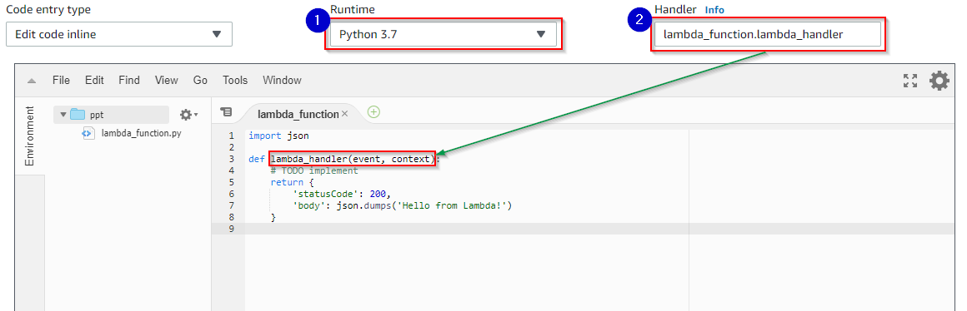

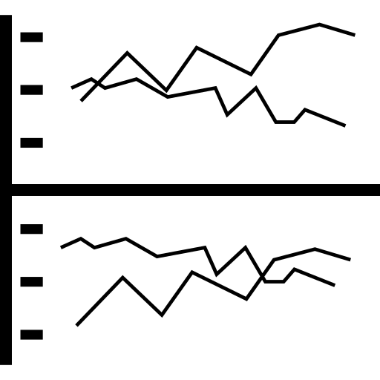
Lambda Concepts
A script or program that runs in AWS Lambda. Lambda passes invocation events to your function.
The function processes an event and returns a response.
Functions
Runtimes
Layers
Log Streams

Slide 26
Lambda Concepts
Function Settings
Functions
Code – the logic you use in the lambda function
Runtime – lambda runtime executes your function
Handler – the method your runtime executes when your function is invoked
Tags – Key-value pairs your function is attached with
Description – describing the function
Timeout – maximum time a function is allowed to execute
Runtimes
Layers
Log Streams

Slide 27
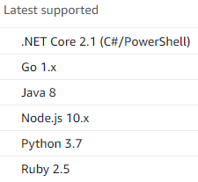
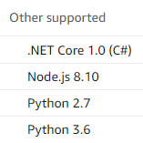
Lambda Concepts
Lambda runtimes allow functions in different languages to run in the same base execution environment.
The runtime sits in-between the Lambda service and your function code, relaying invocation events, context information, and responses between the two.
You can use runtimes provided by Lambda, or build your own.
Functions
Runtimes
Layers
Log Streams

Slide 28
Lambda Concepts
Lambda layers are a distribution mechanism for libraries, custom runtimes, and other function dependencies.
Layers let you manage your in-development function code independently from the unchanging code and resources that it uses.
You can configure your function to use layers that you create, layers provided by AWS, or layers from other AWS customers.
Functions
Runtimes
Layers
Log Streams

Slide 29
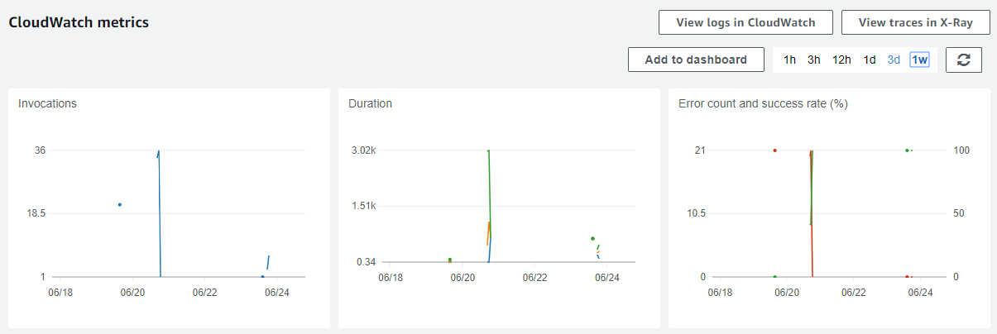
Lambda Concepts
Lambda automatically monitors your function invocations and reports metrics to CloudWatch.
You can annotate your function code with custom logging statements that allow you to analyze the execution flow and performance of your Lambda function to ensure it's working properly.
Functions
Runtimes
Layers
Log Streams

Slide 30
Using AWS Lambda with S3

Slide 31


Using AWS Lambda with S3
microservice
microservice
User
Website
Amazon S3
AWS Lambda
microservice

Slide 32
Hands-on

Slide 33
Hands-on
Create a function
Provide the trigger as S3 and choose the bucket
Upload an object to that bucket
This should have triggered the Lambda function. Go to the monitoring tab under the Lambda console and check the log stream to confirm the invocation of the function

Slide 34
Lambda pricing

Slide 35
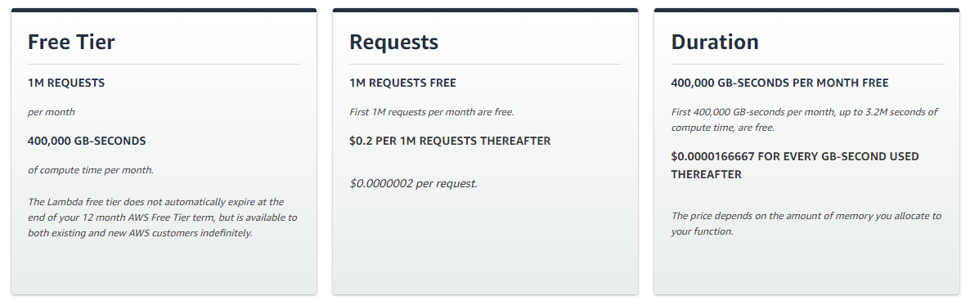
Lambda Pricing

Slide 36
What is Elastic Beanstalk?

Slide 37
What is Elastic Beanstalk?
Beanstalk is a service where you can create, run and manage application without worrying about the underlying infrastructure. It is a PaaS.
You can directly upload your website code to Beanstalk, and it will automatically host the application for you with a URL. You can concentrate on the code of your application rather than the architecture which it is hosted on.

Slide 38
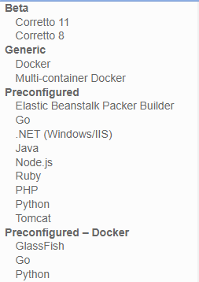
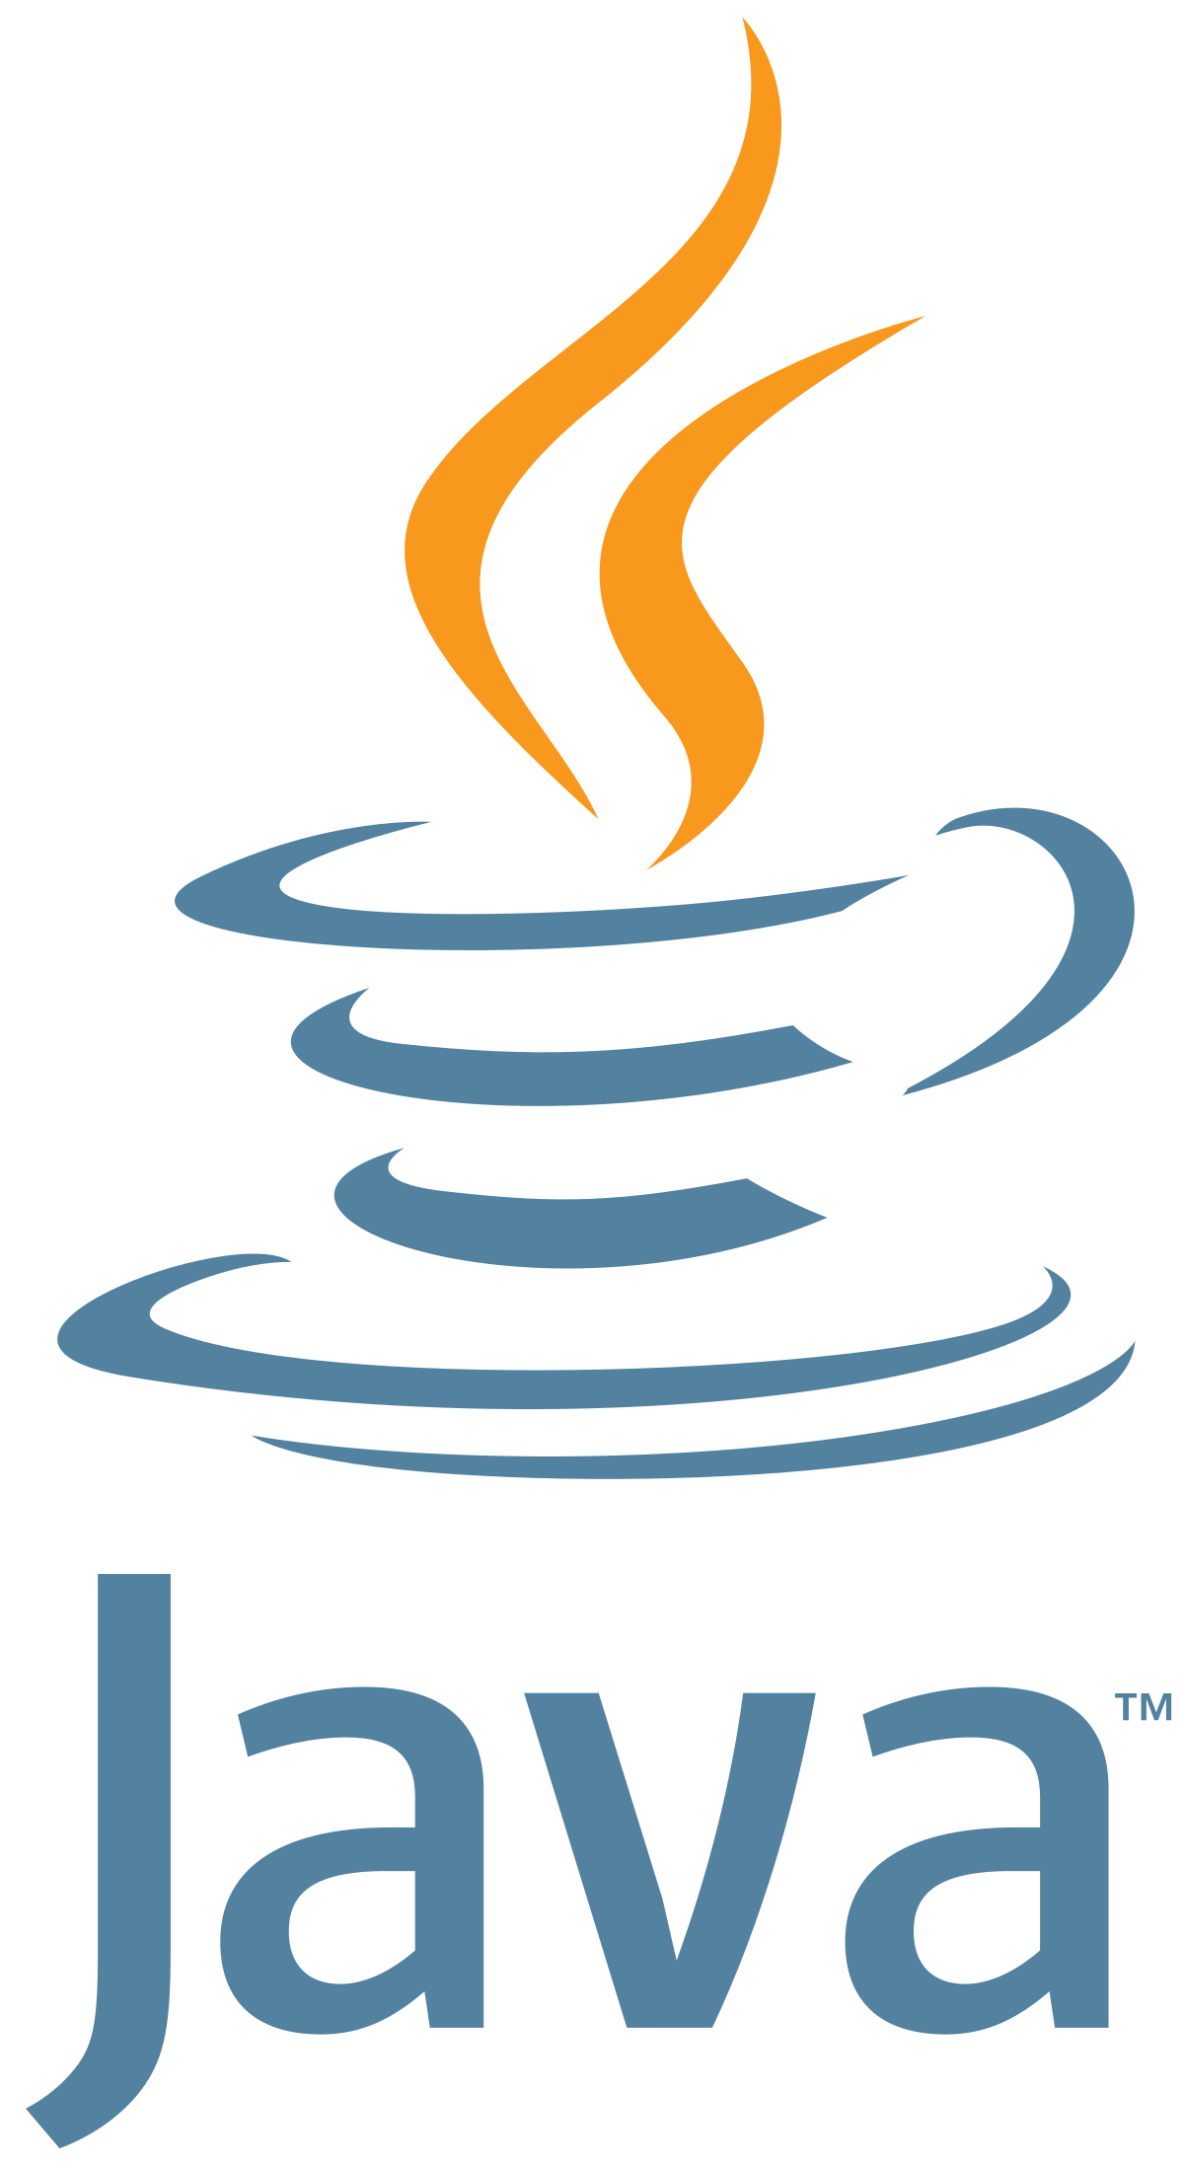



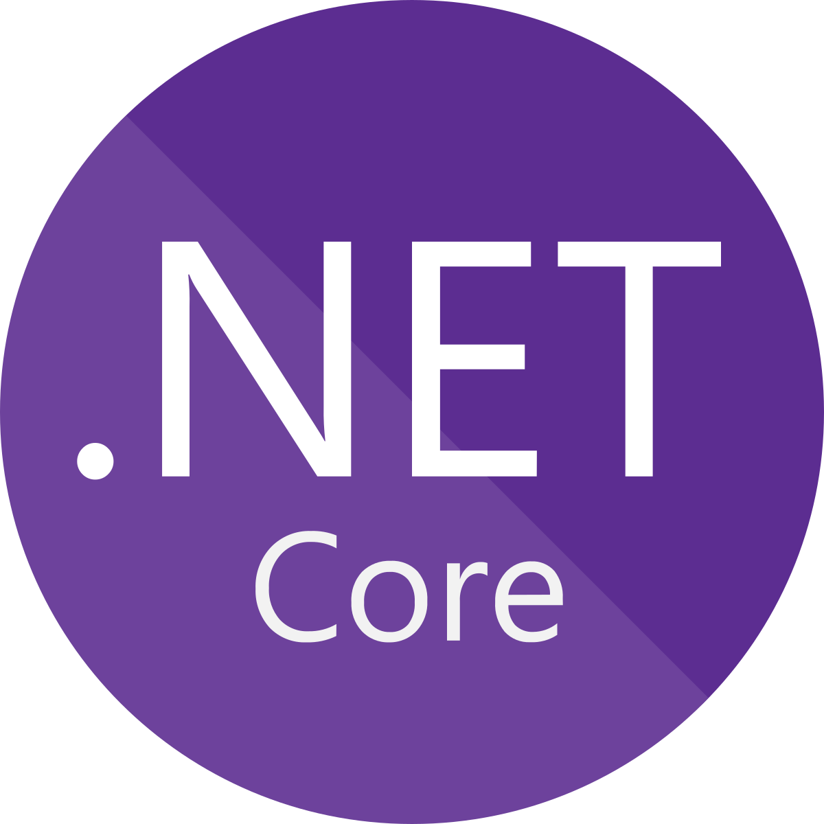

What is Elastic Beanstalk?
Beanstalk supported programming languages

Slide 39
How does Beanstalk work?

Slide 40




How does Beanstalk work?
You can simply upload your code and Elastic Beanstalk automatically handles the deployment, from capacity provisioning, load balancing, auto-scaling to application health monitoring. We will look at the details of it.
Update Version
Upload App
Manage Environment
Create Application
Launch Environment
Deploy New Version

Slide 41
Elastic Beanstalk Concepts

Slide 42
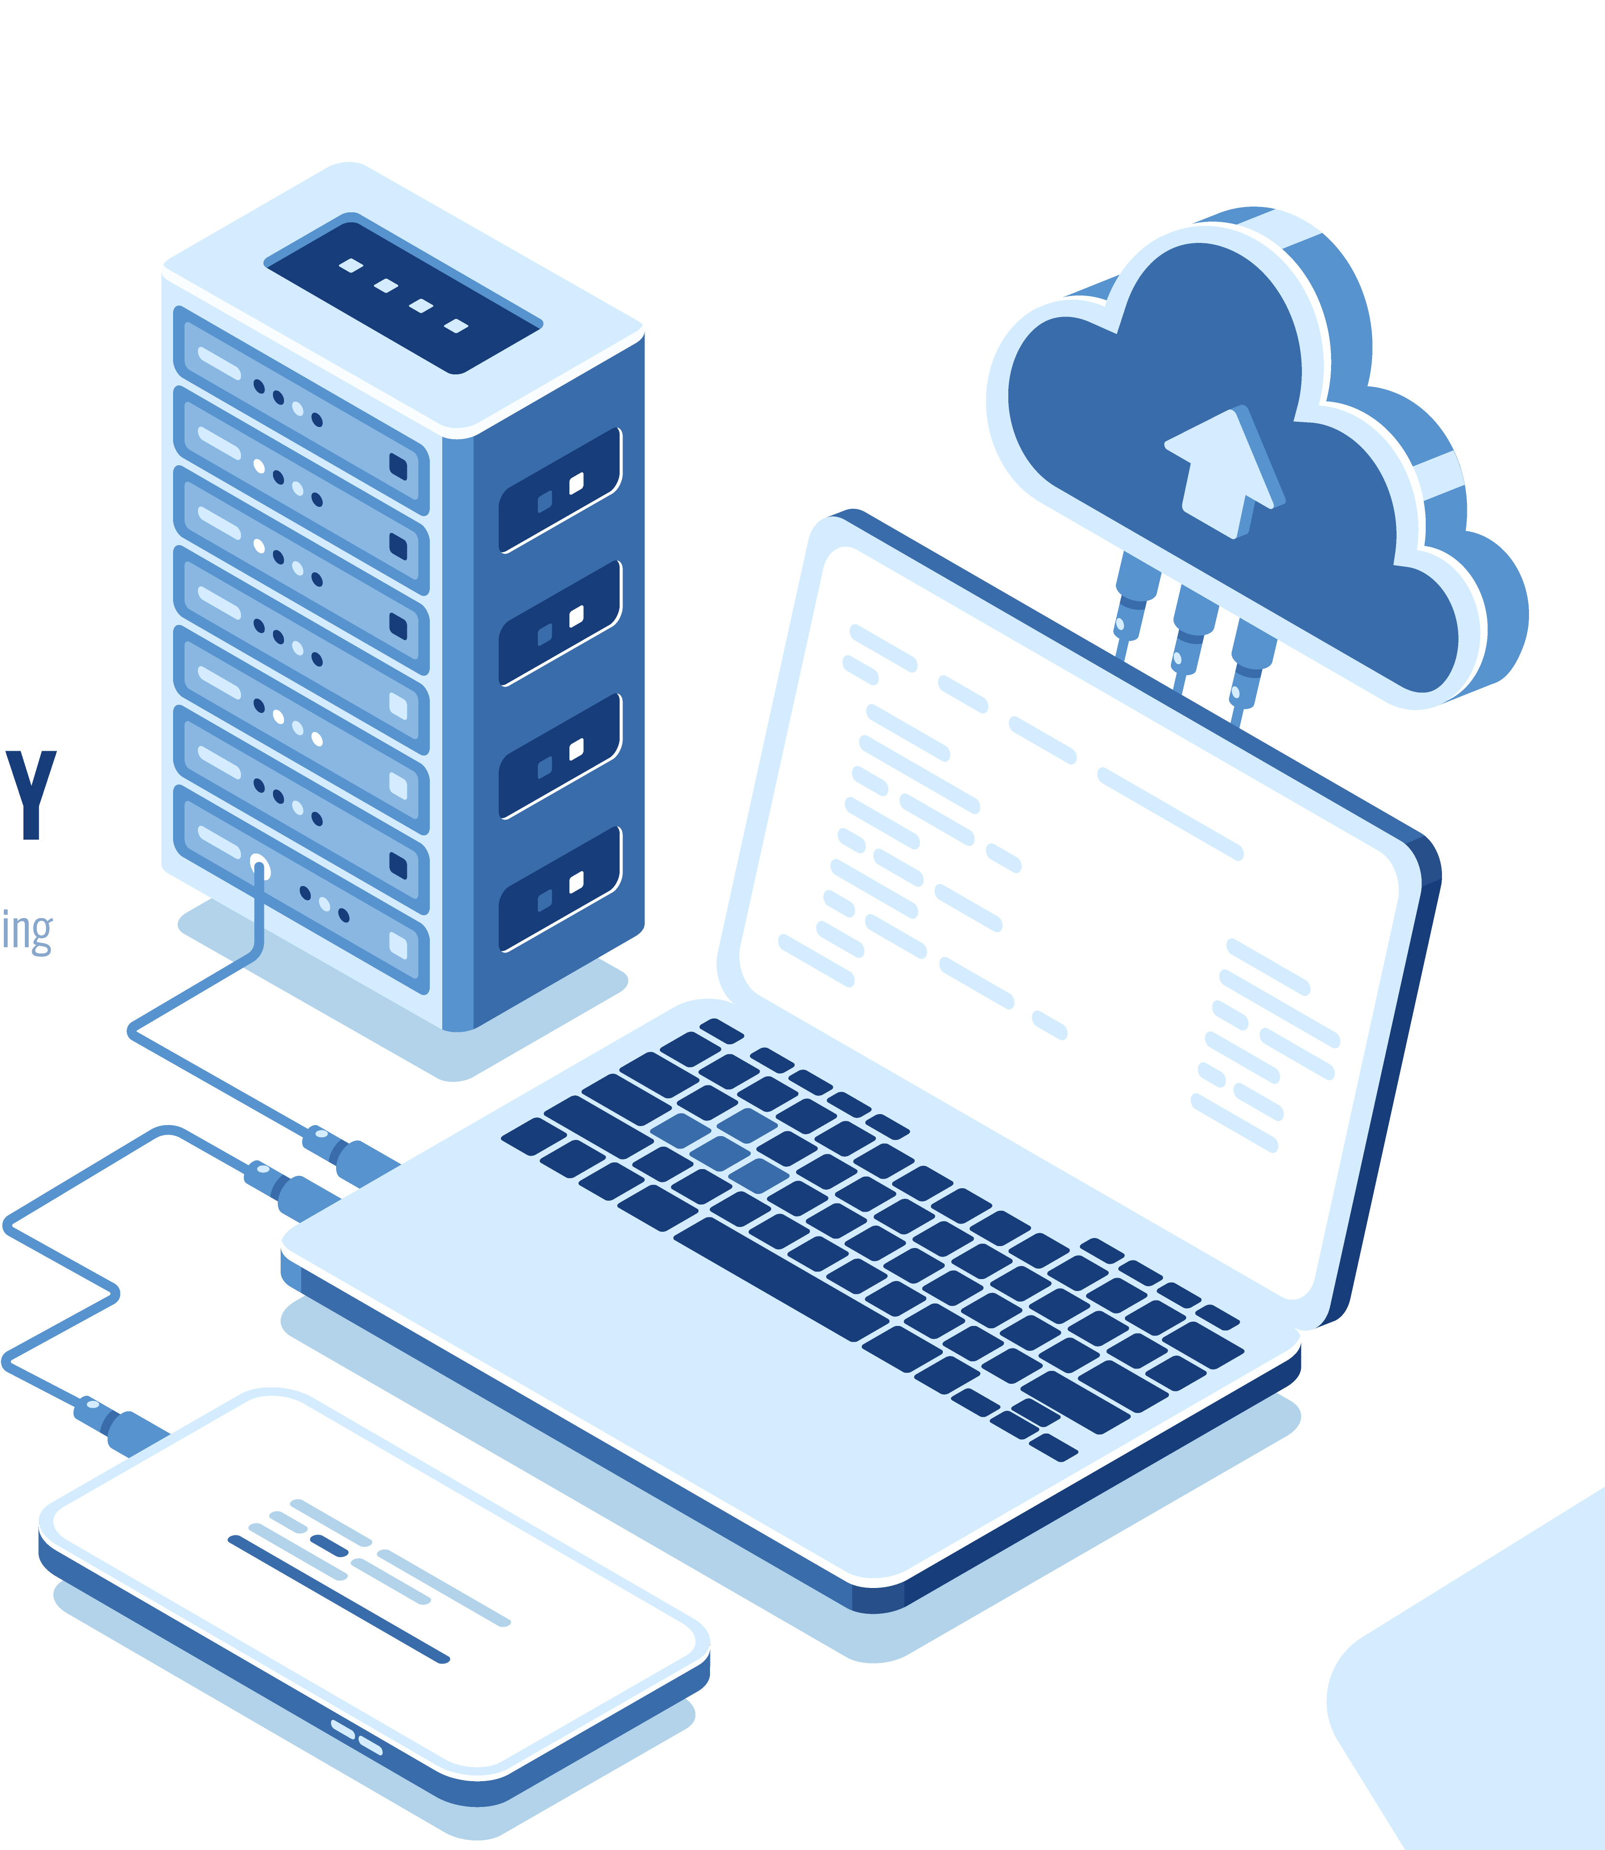
Elastic Beanstalk Concepts
Application
In Beanstalk, an application is the folder you upload which is a logical collection of the app version, environment and configurations
Application Version
Environment
Environment Tier
Environment Configuration
Saved Configuration
Platform

Slide 43


Elastic Beanstalk Concepts
Application
It is a specific iteration of the code which is uploaded to Beanstalk. For example, if first version is 1 then the next would be 1.1 and so on.
Application Version
Environment
Environment Tier
Environment Configuration
Version 1
Version 1.1
Saved Configuration
Platform

Slide 44

Elastic Beanstalk Concepts
Application
An environment is a collection of AWS resources on which your application runs on. In an environment, at a time period, only one version of an application can be running. If you want to run multiple application versions at the same time, then you will have to create more environments and run an other application version on it
Application Version
Environment
Version 1
Version 1.1
Environment Tier
Environment Configuration
Saved Configuration
Platform

Slide 45


Elastic Beanstalk Concepts
Application
When you launch an environment in beanstalk, you will have to choose one of the tiers given below. The tier decides the AWS resources which should be assigned for that environment and the type of application which it can run.
Application Version
Web Server Environment
Worker Environment
Environment
Environment Tier
Using this environment you can directly upload your application’s code and get it hosted
You will be provided with a URL like this myapp.us-west-2.elasticbeanstalk.com
If you have operations in your web server which might take a long time to complete, you can offload them to the worker
For example, a task which processes videos or one which generates a ZIP archive
Environment Configuration
Saved Configuration
Platform

Slide 46
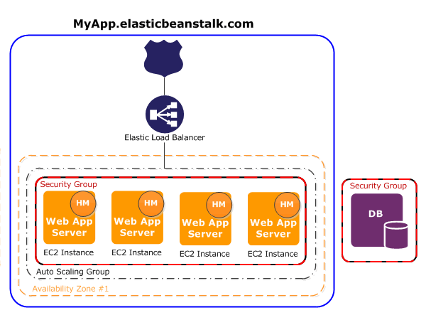
Elastic Beanstalk Concepts
Application
Web Server Environment Architecture
Application Version
Environment
Environment Tier
Environment Configuration
Saved Configuration
Platform
Source: docs.aws.amazon.com

Slide 47
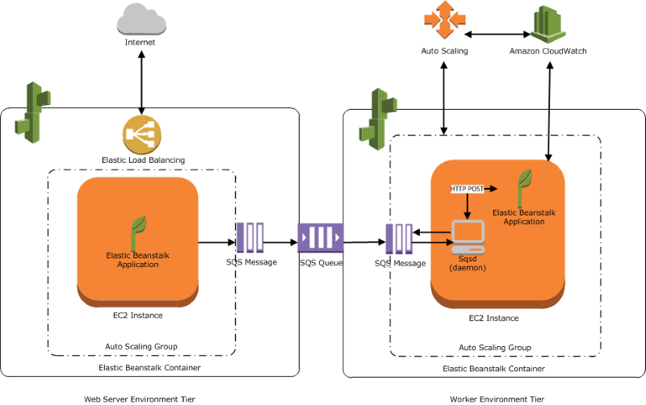
Elastic Beanstalk Concepts
Application
Worker Environment Architecture
Application Version
Environment
Environment Tier
Environment Configuration
Saved Configuration
Platform
Web Server Environment
Worker Environment
Source: docs.aws.amazon.com

Slide 48
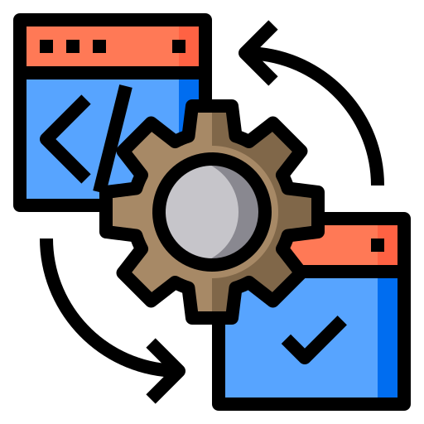
Elastic Beanstalk Concepts
Application
These are the parameters which you enter while creating an environment. Let’s say you have selected Node.js as your runtime, then it will be completely installed on the servers which it spins up.
Application Version
Environment
Environment Tier
You can also update your configuration whenever you need
Beanstalk will either apply the changes to existing resources or deletes and deploys new resources
Environment Configuration
Saved Configuration
Platform

Slide 49


Elastic Beanstalk Concepts
Application
It is a template which you can create. These templates contain the configuration details and you can directly use them to create your own unique environment. Even if you delete the environment which is running, you can create the exact same environment with this template.
Application Version
Environment
Environment Tier
Environment Configuration
Saved Configuration
Platform

Slide 50
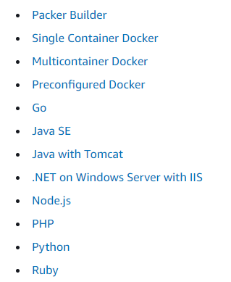
Elastic Beanstalk Concepts
Application
Combination of an operating system, programming language runtime, web server, application server, and Elastic Beanstalk components
Application Version
Environment
Environment Tier
Environment Configuration
Saved Configuration
Platform

Slide 51
Demo: Launching a sample application

Slide 52
Demo: Launching a sample application
Create a web app
Give the application’s name and choose the platform you want (such as PHP)
Click on Configure more options
Go ahead and explore the options; then proceed with the Single instance (Free Tier eligible) because you will not be billed
Once it completes, click on the DNS name provided and view the sample PHP application which is running

Slide 53
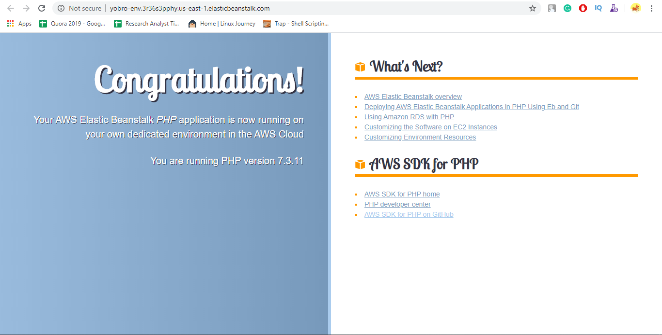
Demo: Launching a sample application
Output of the sample application

Slide 54
Elastic Beanstalk Pricing
There is no additional charge for using Elastic Beanstalk
You pay for the underlying resources which the Beanstalk uses like EC2 servers, RDS databases and S3 storage.

Slide 55
What is Configuration Management?

Slide 56

What is Configuration Management?
The main purpose of Configuration Management is to automate server management
How do we manage? Let’s assume you have 10 similar web servers running and you want to run a configuration update on all of them. To open each server and install that software is a time-consuming process. Instead, you can use create a script and run it on each server automatically to roll updates on all servers at the same time.

Slide 57
What is AWS OpsWorks?

Slide 58
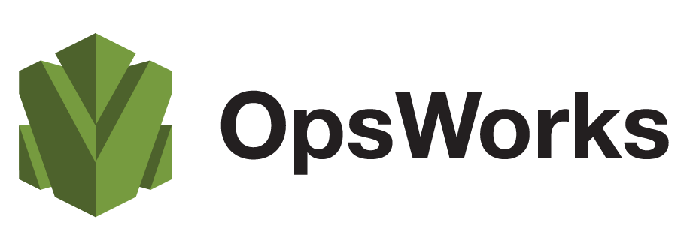


What is AWS OpsWorks?
OpsWorks is a configuration management service which lets you configure and operate applications on the cloud. OpsWorks gives you the benefit of choosing between Chef or Puppet.

Slide 59



AWS OpsWorks Benefits
Support any application
Automation to run at scale
Configuration as Code
Resource Organization

Slide 60
CloudFormation vs OpsWorks

Slide 61
CloudFormation vs OpsWorks
CloudFormation | OpsWorks
Provides business a way of creating a collection of AWS resources in a chronological order | Provides businesses managed instances of Chef & Puppet to automate server management on your EC2 instances or on-premises instances
CloudFormation concentrates mainly on what and how AWS resources are created | OpsWorks mainly works on the orchestration of Servers and managing the software configuration rather than looking into the architecture
Use CloudFormation when you must create multiple architectures of the same design | Use OpsWorks when you must manage the configuration of multiple servers which server a similar purpose
Example: Replication of an available architecture | Example: Installing a web server in 100 instances and running a web page inside them

Slide 62
AWS OpsWorks Services

Slide 63
AWS OpsWorks Services
OpsWorks for Puppet Enterprise lets you create AWS-managed Puppet master servers. A Puppet master server manages nodes in your infrastructure, stores facts about those nodes, and serves as a central repository for your Puppet modules.
AWS OpsWorks for Puppet Enterprise
AWS OpsWorks for Chef Automate
AWS OpsWorks Stacks

Slide 64
AWS OpsWorks Services
AWS OpsWorks for Chef Automate lets you create AWS-managed Chef server. A Chef server manages nodes in your environment, stores information about those nodes, and serves as a central repository for your Chef cookbooks.
AWS OpsWorks for Puppet Enterprise
AWS OpsWorks for Chef Automate
AWS OpsWorks Stacks

Slide 65
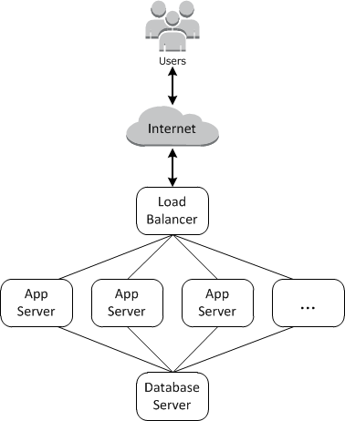
AWS OpsWorks Services
AWS OpsWorks Stacks, the original service, provides a simple and flexible way to create and manage stacks and applications. For example, a web application requires servers, RDS instances, load balancers and storage. A combo of all these resources can be called as a stack.
AWS OpsWorks for Puppet Enterprise
AWS OpsWorks for Chef Automate
AWS OpsWorks Stacks

Slide 66
AWS OpsWorks Stacks

Slide 67

AWS OpsWorks Stacks
Top-level entity of in AWS OpsWorks stacks. It represents a collection of instances which are used for the same purpose, such as nginx or apache2 on them.
Stacks
Layers
Instances
Apps
Customizing your Stack

Slide 68
AWS OpsWorks Stacks
Each stack will have a layer. Each layer describes a component. Like the load balancer layer or database layer.
Stacks
Layers
Instances
Load balancer Layer
Apps
Web Server Layer
Database Layer
Customizing your Stack

Slide 69
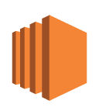
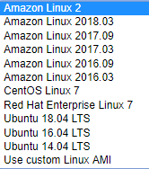
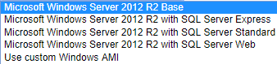
AWS OpsWorks Stacks
Instance is a computing resource like an EC2 instance. It helps in hosting applications, serving a database or load balancing. You can use Linux distributions or Windows Server 2012 R2.
Stacks
Layers
Instances
Apps
Customizing your Stack

Slide 70

AWS OpsWorks Stacks
OpsWorks app option represents the code that you want to run on the server. The code can reside in S3 or a repository like GitHub. App has the information required to deploy the code to app servers.
Stacks
Layers
Instances
Apps
Customizing your Stack

Slide 71
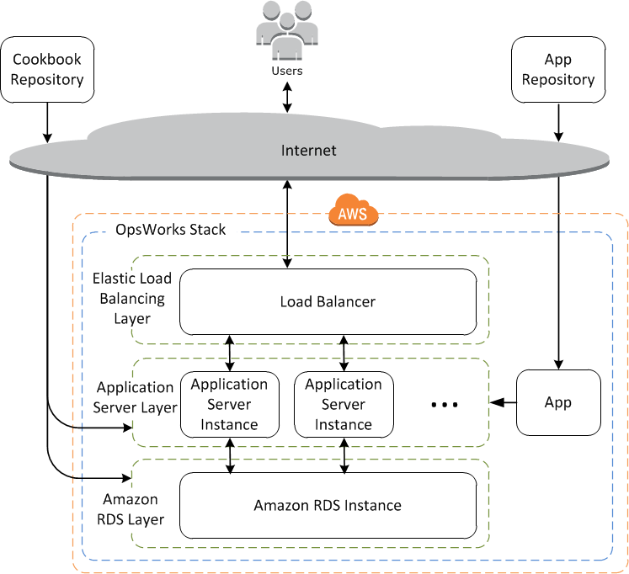
AWS OpsWorks Stacks
Stacks
Layers
Instances
Apps
Customizing your Stack

Slide 72
Demo: Launching a sample stack

Slide 73
Demo: Launching a sample stack
Create a stack by clicking on the sample stack option
Go to instances and before clicking on start, edit the instance’s configuration by changing instance type from t2.medium to t2.micro so that you don’t get charged for it.
Then click Start and explore the other options in the stack. Such as apps.
Once the instance is running, go to the public IP and find the website successfully hosted
Delete the stack after deleting the instances

Slide 74
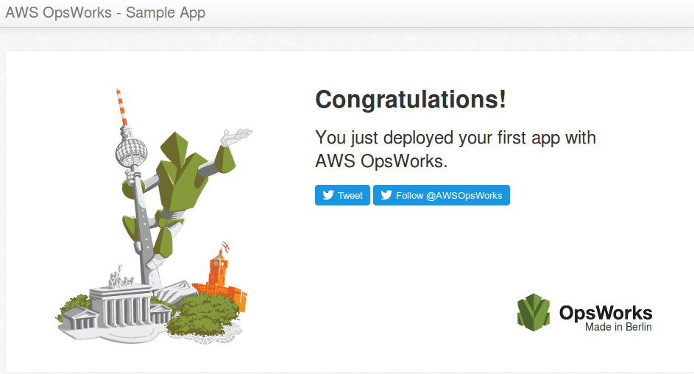
Demo: Launching a sample stack
Output of the sample application

Slide 75
AWS OpsWorks Pricing
There is no additional charge for using OpsWorks Stacks
You pay for the underlying resources which the OpsWorks uses like EC2 servers, RDS databases.
The pricing for each on-premises server on which you install the OpsWorks Stacks agent is $0.02 per hour

Slide 76
Quiz

Slide 77
Quiz
1. What is the maximum time out period of a Lambda function?
A. 10 seconds
B. 10 minutes
C. 15 minutes
D. 200 seconds

Slide 78
Quiz
2. What cloud service model does Elastic Beanstalk come under?
A. IaaS
B. PaaS
C. SaaS
D. FaaS

Slide 79
Quiz
3. Elastic Beanstalk uses EC2 for hosting the application.
A. Yes
B. No

Slide 80
Quiz
4. OpsWorks runs both Chef and Puppet on the same server.
A. Yes
B. No

Slide 81
Quiz
5. What type of a computing platform is Lambda?
A. Serverfull
B. Serverless
C. Code as an Infrastructure
D. Database

Slide 82

India : +91-7847955955
US : 1-800-216-8930 (TOLL FREE)
support@intellipaat.com
24X7 Chat with our Course Advisor
Notes:
Thank you!

